Slide 1
Terror Attack in the US (1970~2015)
An in-depth analysis of global terrorism database

Slide 2
Introduction
Nature of US Terror Attack Brought to Spotlight by Certain Executive Order
How does the big picture of terror attacks in the US look like
How Have The Attacks In US Changed Over Time?
Are There Any Attack Patterns By Date And Types?
Where In the US Did These Attacks Happen?
What Are the Group Affiliations of US Terror Attacks?

Slide 3
Introduction of Global Terrorism Database (GTD)
A terrorism incident database maintained by the National Consortium for the Study of Terrorism and Responses to Terrorism (START) at the University of Maryland, College Park
Covers terrorism incidents that happened between 1 January 1970 and 31 December 2015
Contains 156,772 incidents from the year of 1970 to the year of 2015, with 137 variables
We created a sub-date frame with 2164 US attacks and 56 variables

Slide 4
R Tools
Data Cleaning
dplyr, stringr, lubridate, purr, tidyverse, reshape2, forcats
Visualization
ggplot2, plotly,
Mapping
ggmap

Slide 5
Question of WHEN

Slide 6
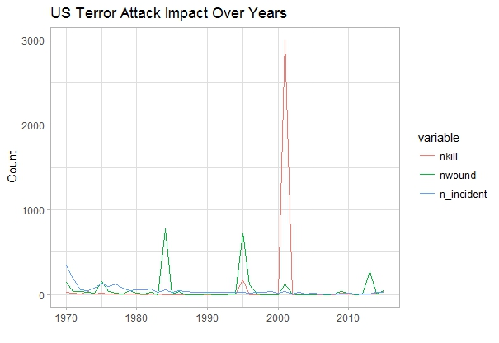
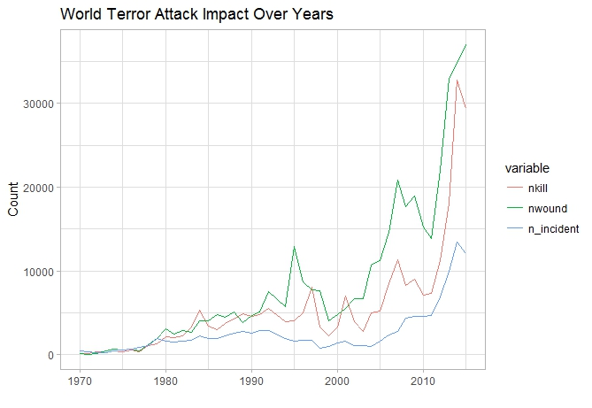
US vs. World Attacks Over Years

Slide 7
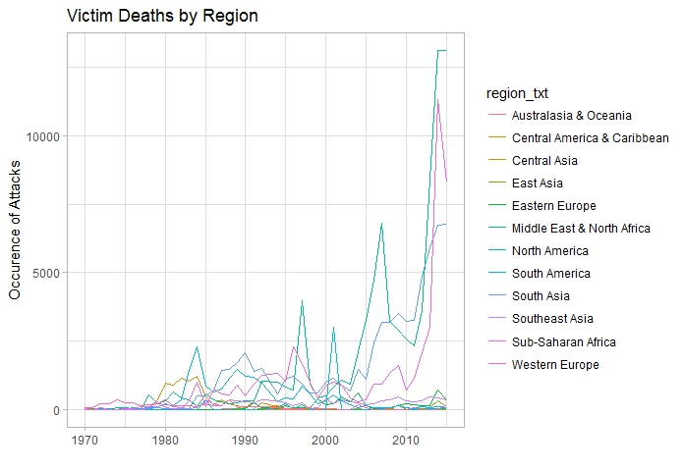
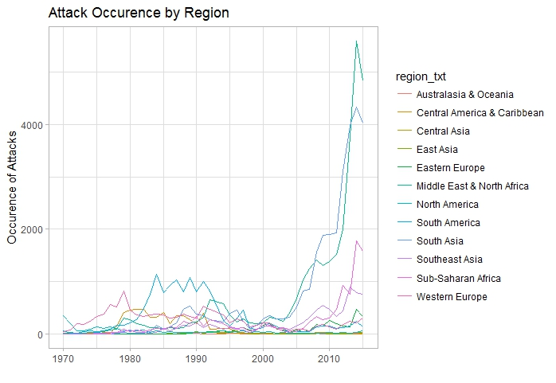
Attack Count and Death by Region

Slide 8
Question of HOW

Slide 9
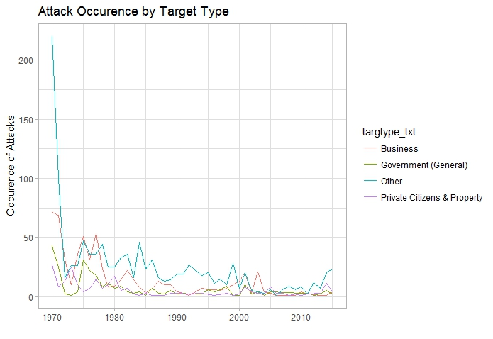
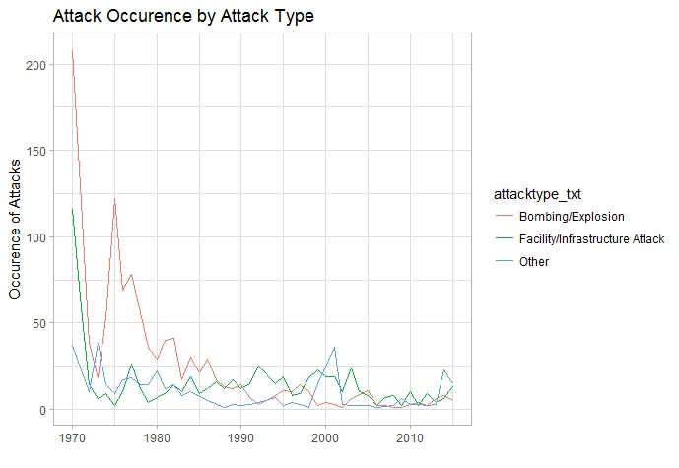
Attack Type and Target Type (45 Years)

Slide 10
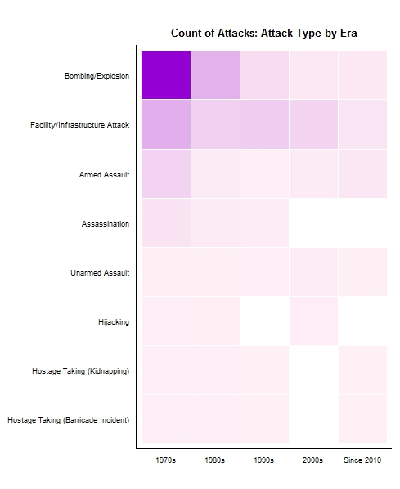
Attack Type Over Era

Slide 11
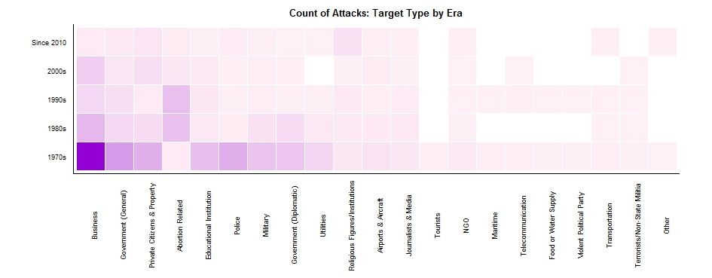
Target Type Over Era

Slide 12
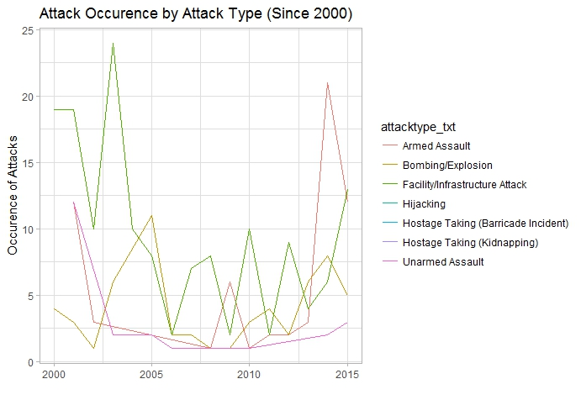
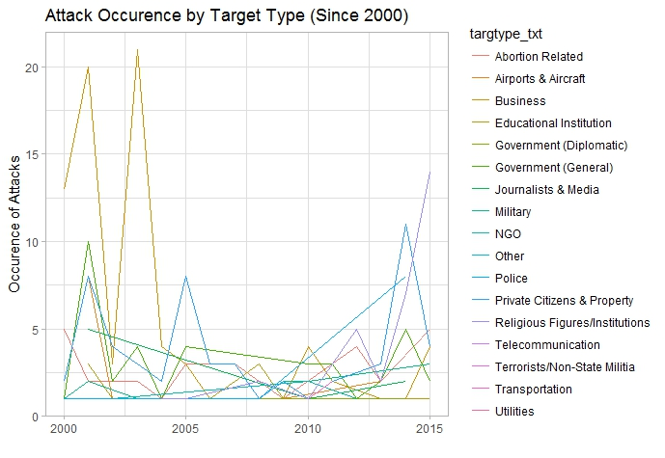
Attack Type and Target Type (Since 2000)

Slide 13
Question of WHERE

Slide 14
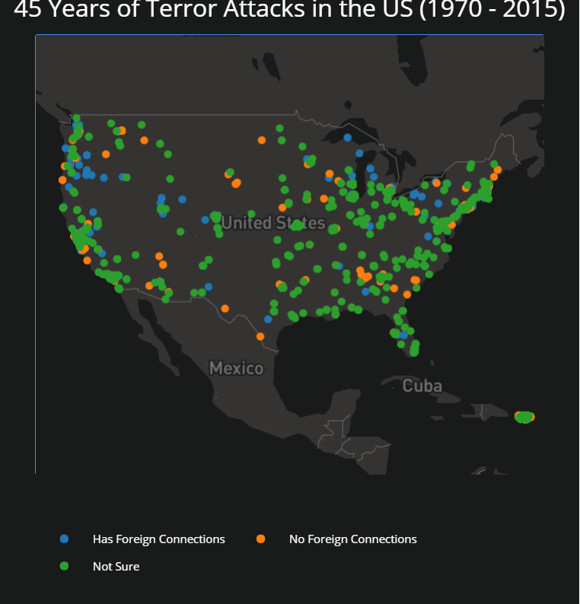
Attack by Foreign Link

Slide 15
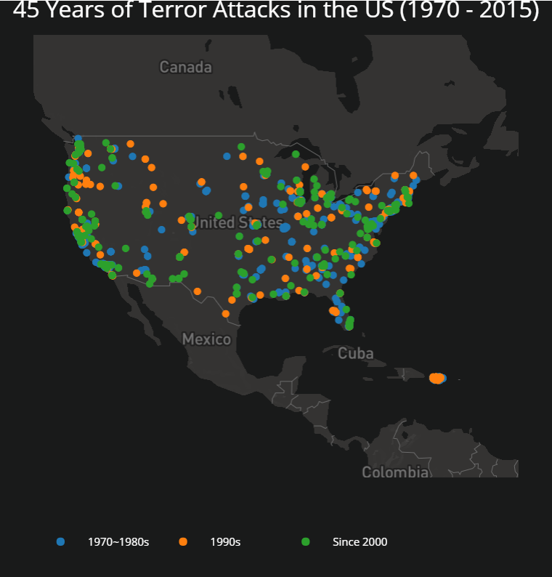
Attack by Era

Slide 16
Question of WHO

Slide 17
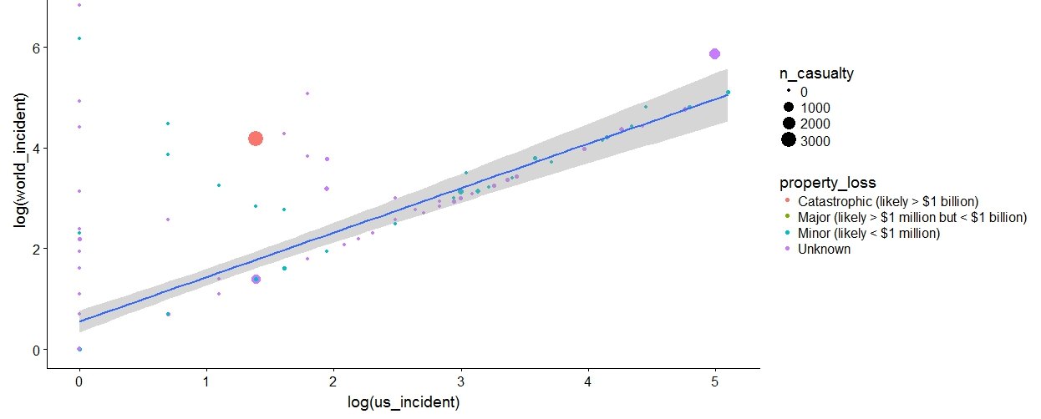
Terrorism Groups: World Attacks and US Attacks

Slide 18
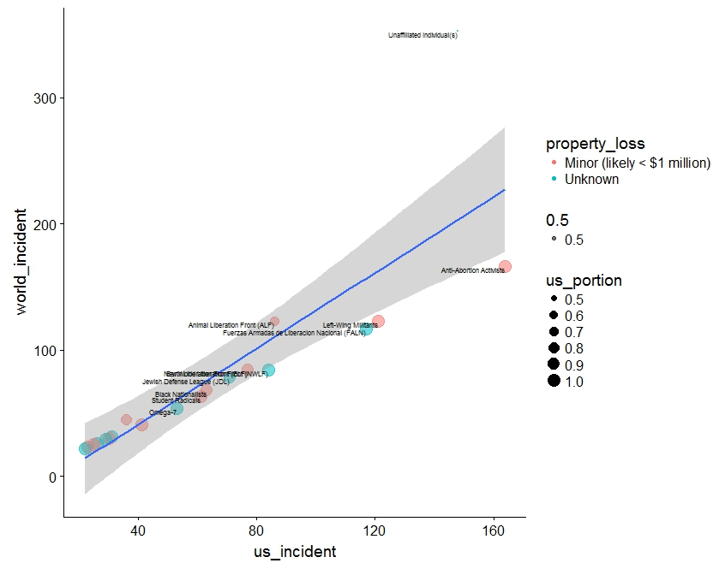
Terrorism Groups: 20 Most Active in US

Slide 19
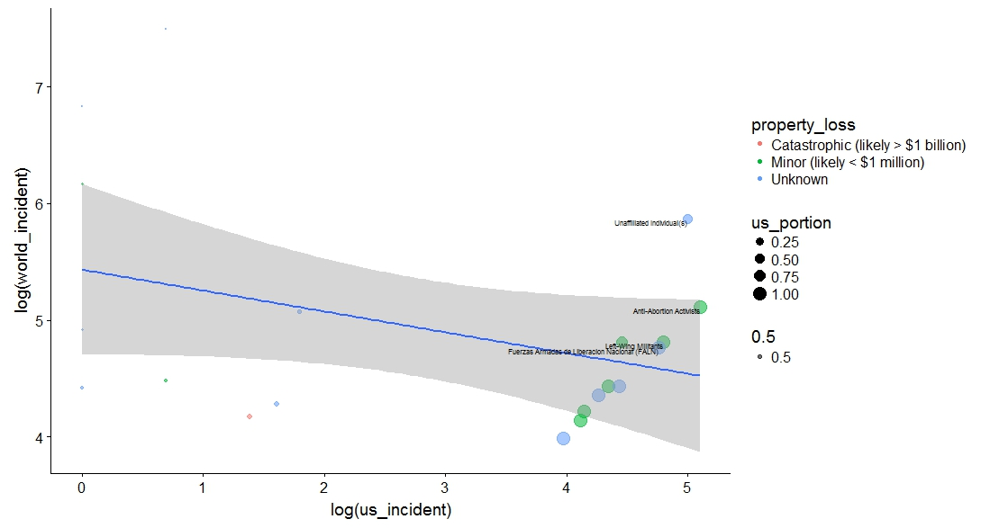
Terrorism Groups: 20 Most Active in World

Slide 20
Conclusion
Outlier of large loss of property and life does exist
Foreign links are not as strong as one might assume
Domestic originated attacks take a large portion
Does the executive order really help?

